Slide 1
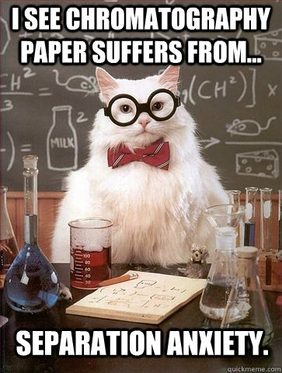

Slide 2
A2 Chemistry
Chromatography

Slide 3
Learning Intention
data from chromatography techniques, including thin layer chromatography (TLC), gas chromatography (GC), and high-performance liquid chromatography (HPLC), can be used to determine the composition and purity of substances; the separation of the components is caused by the variation in strength of the interactions between atoms, molecules or ions in the mobile and stationary phases

Slide 4
Success criteria
State the stationary phase, mobile phase, detection phase and application or example of use for each of
TLC
GC
HPLC
PC

Slide 5
Key words
Stationary phase
Mobile phase
Detection phase
Adhesion
Cohesion

Slide 6
Chromatography
chroma "colour" and graphein "to write“
laboratory technique for the separation of mixtures

Slide 7
Phases
The mixture is dissolved in a fluid called the mobile phase, which carries it through a structure holding another material called the stationary phase. The various constituents of the mixture travel at different speeds, depending on the strength of their interaction with the stationary phase.
There are different techniques to detect the separation of each component.

Slide 8


Slide 9
Chromatography may be preparative or analytical.
Preparative chromatography is a form of purification; it separates the components of a mixture for more advanced use
Analytical chromatography is done normally with smaller amounts of material and is for measuring the relative proportions components in a mixture.

Slide 10
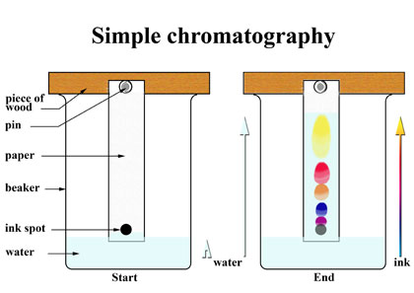
Paper chromatography

Slide 12
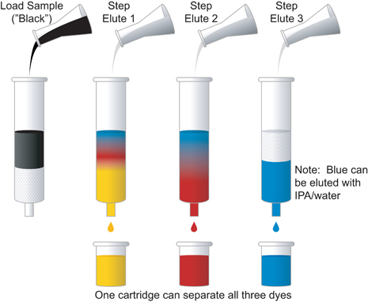
Column chromatography

Slide 13
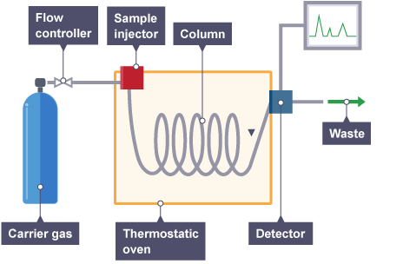
Gas chromatography

Slide 14
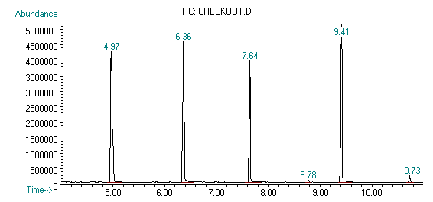
HPLC chromatograph

Slide 15
Success criteria
State the stationary phase, mobile phase, detection phase and application or example of use for each of
TLC
GC
HPLC
PC

